Slide 1
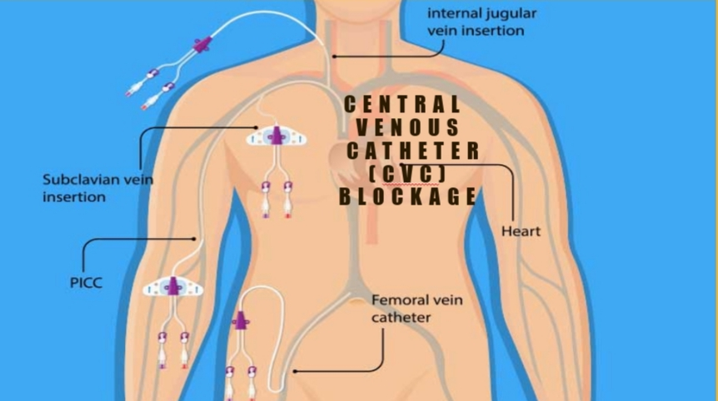
CENTRAL LINES MAINTENANCE IN PEDIATRICS

Slide 2
CONTENTS
Definition
Indication for CVCs
Types of CVCs
Care and blockage management

Slide 3
WHAT IS CENTRAL VENOUS CATHETER ?
-CVC is a line that reaches to the central circulation -Catheter (tube) that is passed through a vein to end up in the thoracic ( chest) portion of the vena cava.(the large vein returning blood to the heart) or in the right atrium of the heart. Central venous catheters have a number of different uses.

Slide 4
INDICATIONS FOR CVCS...
-Chemotherapy
-Long term treatment (antibiotics, albumin, calcium infusion, blood transfusions, immunoglobulin, intravenous fluids electrolytes, TPN).
-CVP monitoring
-Hemodialysis and plasmapheresis
-Difficult cannulation

Slide 5
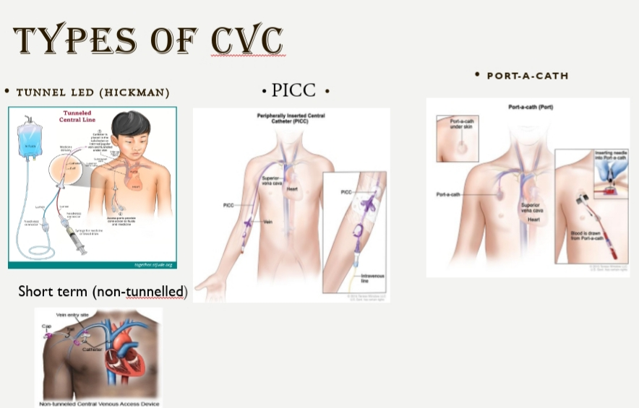
TYPES OF CVCS…
Short term central lines: 1. Non-tunneled 2. Examples: Percutaneous lines with multiple lumens (Arrow/Cook), peripherally inserted central catheter (PICC). Long term central lines: 1. Tunneled 2. Example: Hickman, perm catheter, and Implanted port

Slide 6
MAINTENANCE CARE OF THE COMMONLY USED CENTRAL LINES

Slide 7
DRESSING
Change gauze dressing every 48 hours • Once there is no oozing from the CVC exit site, change to transparent dressing "Tegaderm" Tegaderm to be changed each 7 days, unless soiled, loose, dumped. • Chlorhexidine Impregranted Tegaderm can be used for patients with frequent CLABSI despite strict adherence to maintenance bundle elements. It can be used in patients with immunodeficiency.

Slide 8
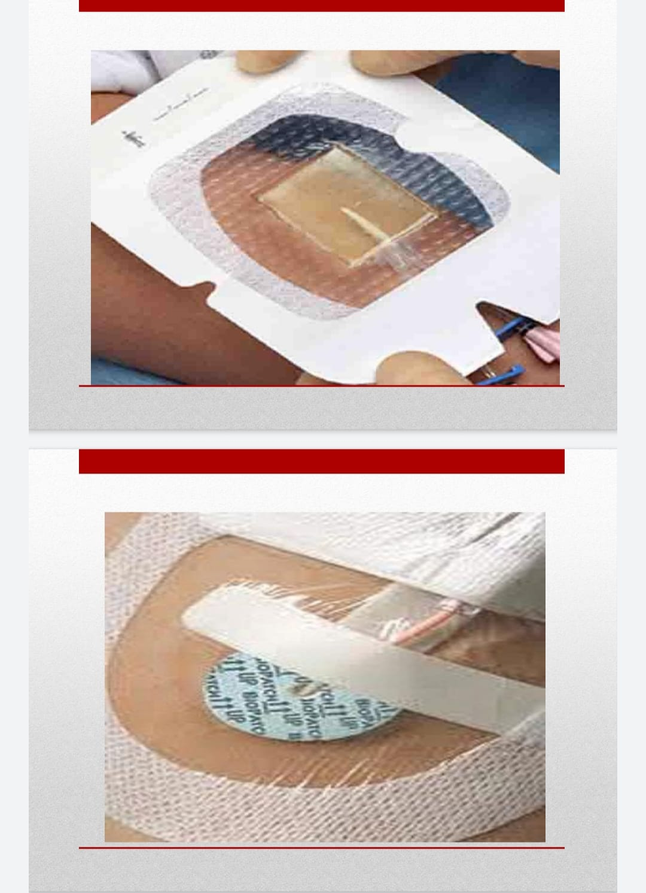

Slide 9
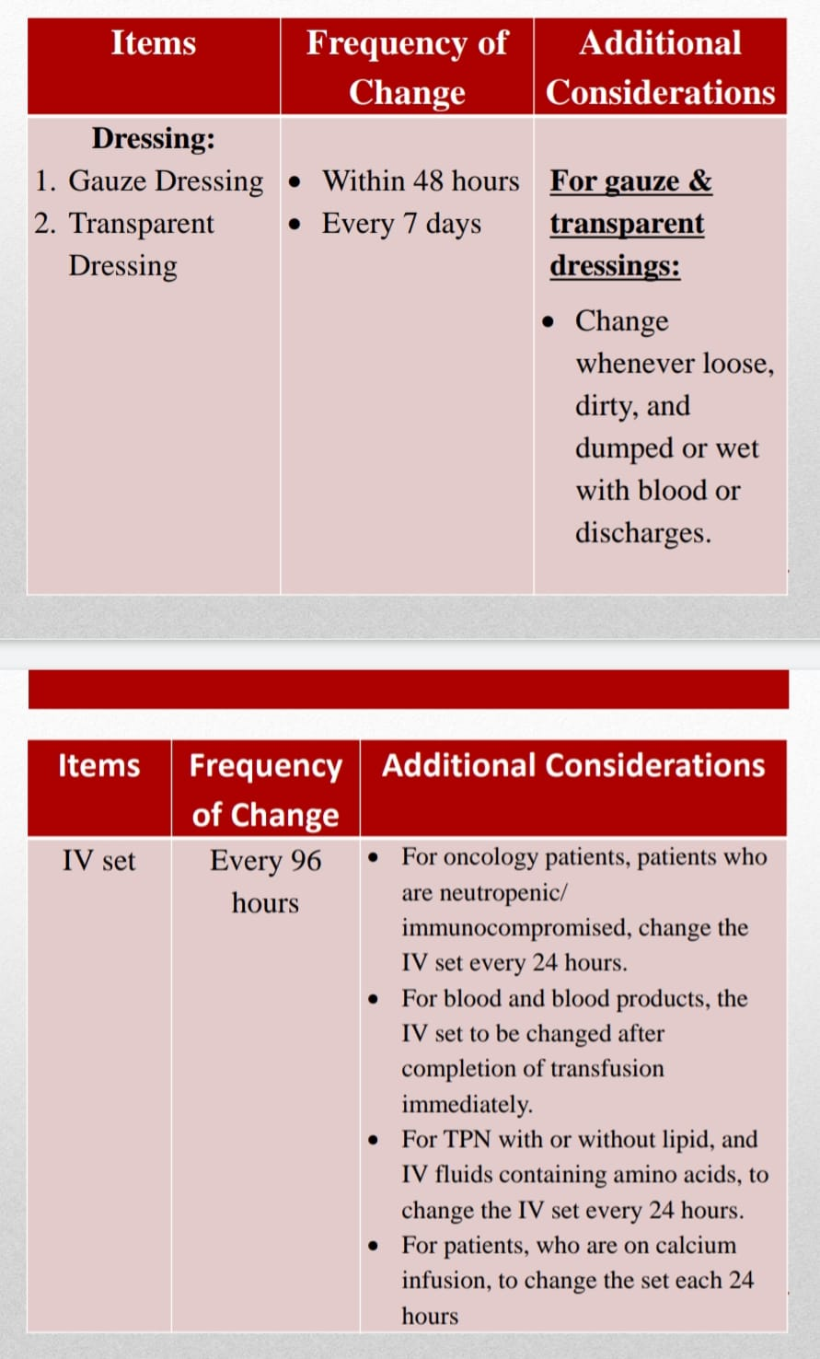

Slide 10
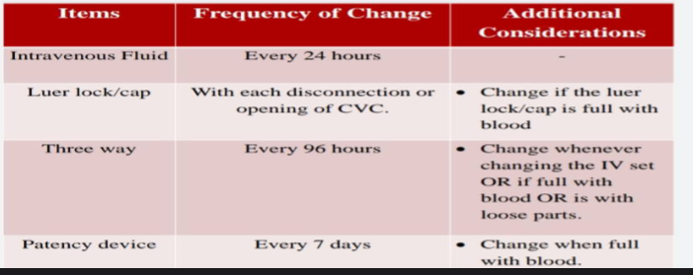

Slide 11
PREVENTING CENTRAL VENOUS CATHETERS BLOCKAGE
To avoid cvc blockage
Use of patency devices to avoid line thrombosis. If used,patency devices should be changed every 7 days.
Use appropriate amount of 0.9% saline following viscous and non-viscous solutions,blood collection and withdrawal of blood .
Follow the push and pause or pulsatile flushing technique and the positive pressure technique for flushing the CVCs.pulsatile technique helps to remove the residuals of medications or blood that adheres to the internal surface of the catheter.while the positive pressure technique ensures creation of a pressure inside the catheter that prevents backflow of the blood in to the catheter lumen.
Use 10 ml syringes to flush the centrallines after use
Alternate the use of different lumens for blood sampling. Use the wider lumens for blood sampling
Choose the right size of CVC appropriate for the child to avoid venous thrombosis

Slide 12
Recommended Saline Flush Volumes Before, In Between and After Administration of Drugs/blood and Blood Sampling

Slide 13
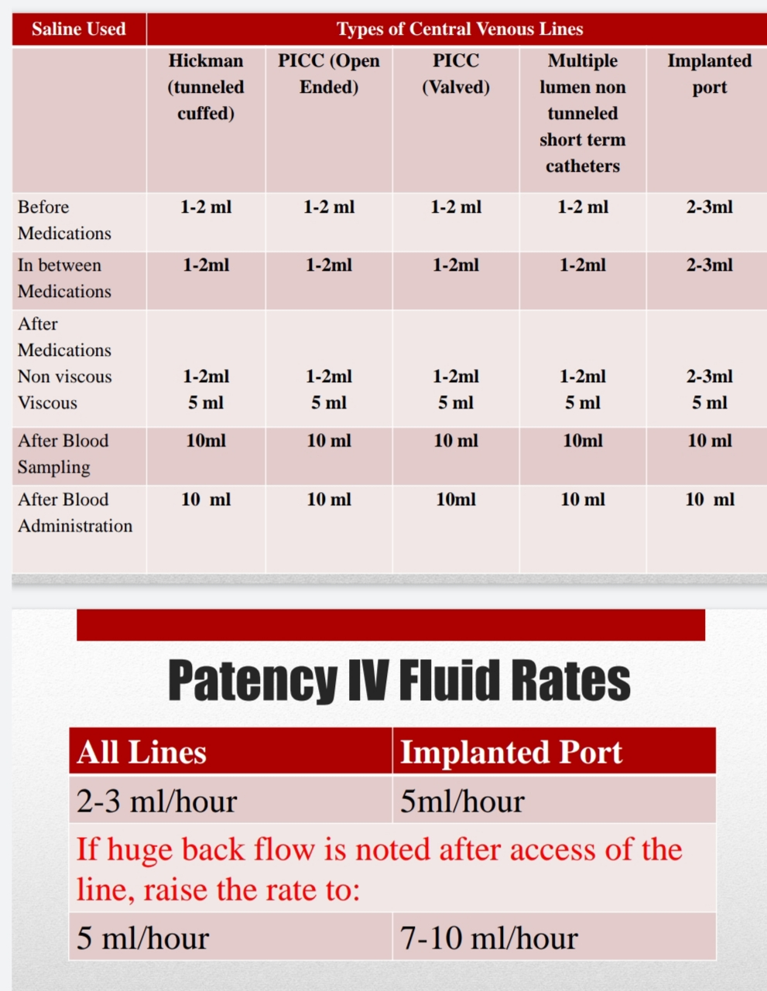

Slide 14
MIXING TECHNIQUE
If the patient is receiving IV fluid, containing electrolytes, through a single lumen central line, still UE 1can be collected from that central line.
This technique can be used to obtain different sort of blood samples.

Slide 15
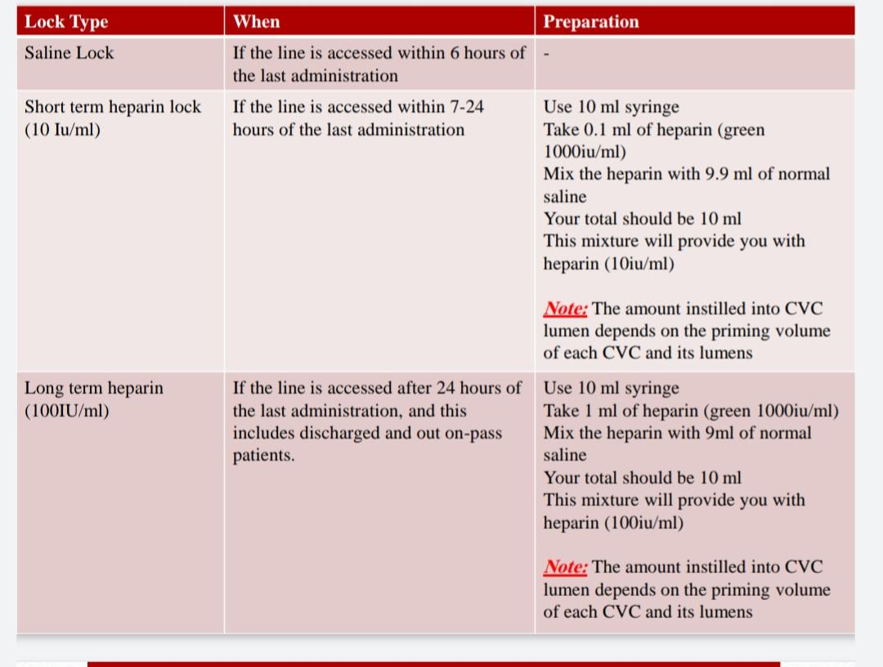
RECOMMENDED TYPES AND FREQUENCY OF SALINE AND HEPSALINE LOCKS USE

Slide 16
IMPORTANT REMINDERS
Please consider child’s overall fluid state
Push and pause or pulsatile technique must be used for flushing all the CVCs
Please note the higher volumes of saline flush of 5-10 ml can be used after viscous medication ,after blood sampling and blood administration in children where volume status is not restricted
All tunneled ( non cuffed) and picc lines need daily flush
Hickman /broviac need flush and relock every 7 days
Implanted ports can be flushed every 4 weeks

Slide 17
PRIMING VOLOUME OF PAEDIATRIC CVC

Slide 18
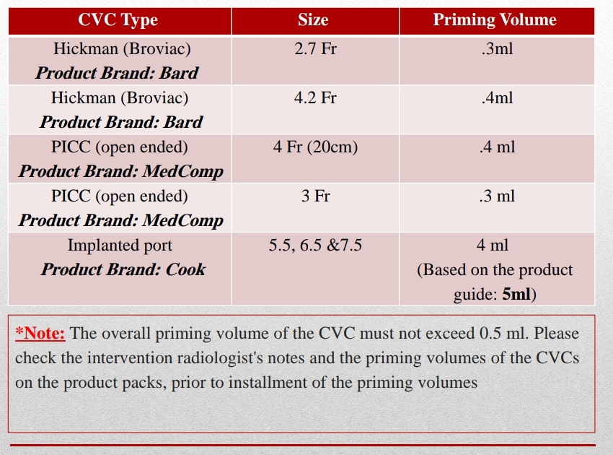

Slide 19
In case of lumen obstruction the following steps are advised...
Assess the site for redness,tenderness and swelling
Flush the lumen with 0.9% normal saline to check the patency of the catheter
Aspirate each lumen to determine if easy to flush and aspirate

Slide 20
MANAGEMENT OF THROMBOTIC OBSTRUCTION OF A LUMEN
Flush and aspirate the lumen to make sure about patency
Check back flow with small syringe (1ml or 3ml)as it has less negative pressure withdrawing
Do not try to flush the lumen with small syringe because of high positive pressure
If the lumen is blocked administer thrombolytic agent and the thrombolytic agent should be aspirated after dwell time
Please consult the most senior physician (consultant)before requesting for thrombolytic agent

Slide 21
CONT...
It is recommended to instill up to 2 doses of alteplase to fill up the catheter lumen dead space (the priming voloume of the catheter
Keep the dwelling time for thrombolytic agent 30-120 minutes for first dose
In case of catheter is not fully patent,repeat 2nd for 30 minutes can be administered
Reteplace can also be used for unblocking of blocked lumens

Slide 22
AUDIT
Central line form should be filled every shift and any patient came to PHDU with cvc should be audit in audit book

Slide 23
REFERENCES…
> Pennsylvania Patient Safety Authority, 2011. Assessment of Program for Prevention of Central-Line Associated Bloodstream Infections [Online]. Available at: http://www.patientsafetyauthority.org.[Accessed on 28/02/2016].
> Safdar, N. et al. 2016. Making Health Care Safer II: An Update Critical Analysis of the Evidence for Patient Safety Practices. Chapter 2 Prevention of Central Line Associated Bloodstream Infections (Brief Update Review).
>The Joint Comission. 2013. CVC Maintenance Bundles[Online]. Available at: http://www.jointcommission.org/CLABSITToolkit [Accessed on 28/02/2016].
> www.bestcare.org.za [Accessed on 28/02/2016)..

Slide 24
> Alexander, M. et al. 2011. Guidelines for the prevention of intravascular catheter related infections. American Journal of Infection Control 39 (4), pp. SI-234.
> Bani Ahmed, N. 2013. Guidelines for Venous Access Devices. Oman: Royal Hospital.
> California Department of Public Health (CDPH). 2013. Central line-associated bloodstream infection. In Basics of Infection Prevention 2-Day Mini Course.
> National Center of Emerging and Zoonotic Infectious Diseases. Checklist for prevention of Central Line Associated Blood Stream Infections[Online]. Available at: http//www.cdc.gov/hicpac/pdf/guidelines/bsi-guidelines-2011.pdf [Accessed on 28/02/2016]

Slide 25

THANK YOU
MIDHUL MICHAEL

